Slide 1
DS
Intro to the Standard Template Library

Slide 2


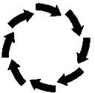
Intro To The Rationale
Learned about
new data structures
Linked list
Stack
Queue
Circular array
Hash table
Notes:
http://www.tech-search.co.uk/img/general/chain.jpg
http://www.mathworks.com/matlabcentral/fx_files/24238/2/queue_line_2.jpg
http://courts.oregon.gov/OJD/images/programs/utcr/duplicate1_arrows.gif

Slide 3
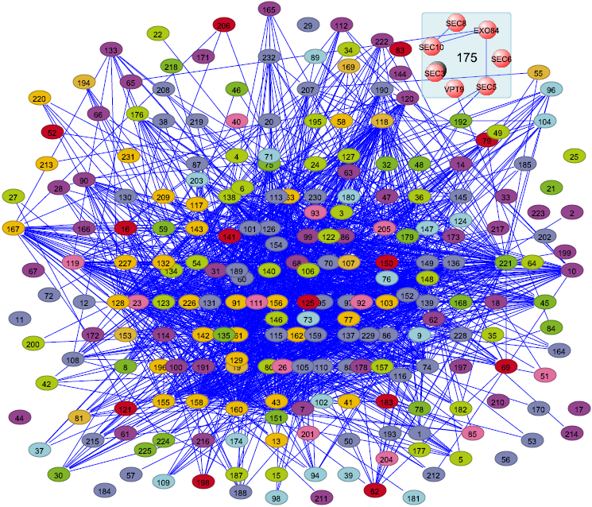
Non-trivial
amount of code needed
Notes:
http://visant.bu.edu/images/complex_y2h_big.png

Slide 4
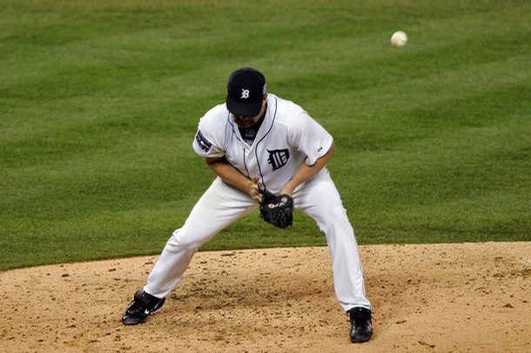
Can be error-prone
Notes:
http://www.nicknormal.com/normalblog/wp-content/uploads/2009/02/todd-jones-detroit-error_whoopwhoop.jpg

Slide 5

There is a better way!
Notes:
http://couponlove.files.wordpress.com/2011/01/yay.jpg

Slide 6
Standard
Template
Library
(C++ only)

Slide 7
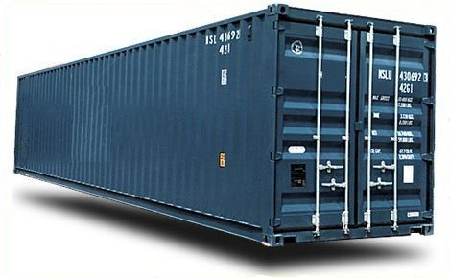
Containers for data
Notes:
http://www.incoterms-2010.net/wp-content/uploads/2011/02/incoterms-2010-container.jpg

Slide 8
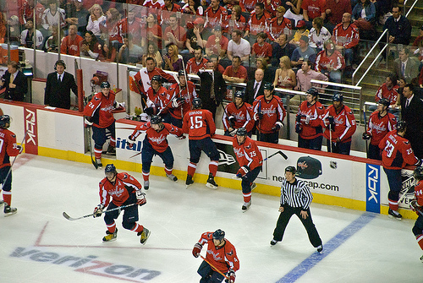
Replacements for your own data structures
Notes:
http://static.flickr.com/3273/2411545885_16cf00101c.jpg

Slide 9

e.g.
Vector replaces linked list
Deque replaces queue
Notes:
http://www.sportsblognetwork.net/wp-content/uploads/2010/07/carey-price-jaroslav-halak-montreal-canadiaens-substitution1.png

Slide 10

Reading
You should review templates
Notes:
http://upload.wikimedia.org/wikipedia/commons/thumb/6/63/Textbook.JPG/220px-Textbook.JPG

Slide 11
There are many online resources:
STL Tutorials: http://www.codeproject.com/vcpp/stl/stlintroduction.asp
SGI Reference Guide: http://www.sgi.com/tech/stl/
Covers a lot but doesn’t go into a lot of detail, though

Slide 12
Example 1
Read in an arbitrary number of integers (n >= 1) from “numbers.txt” and display:
Minimum, maximum
Median
Average
How many lines would it take you?
arbitrary storage (for median), sorting, loops…

Slide 13

Example 1: STL solution
vector<int> v;
copy(istream_iterator<int>(ifstream("numbers.txt")),
istream_iterator<int>(), back_inserter(v));
sort(v.begin(), v.end());
printf("min/max: %d and %d\n", v.front(), v.back());
printf("median: %d\n", *(v.begin() + (v.size()/2)));
printf("average: %d\n", accumulate(v.begin(), v.end(), 0.0) / v.size());
Notes:
http://media.comicvine.com/uploads/1/15092/418814-StupendousMan.jpg

Slide 14
Example 2
Write a program that outputs the words in a file and the number of times it occurs, sorted by word
File input, hashtable, hash function…

Slide 15
Example 2: STL solution
vector<string> v;
map<string, int> m;
copy(istream_iterator<string>(ifstream("words.txt")), istream_iterator<string>(), back_inserter(v));
for (vector<string>::iterator vi = v.begin();
vi != v.end(); ++vi)
++m[*vi];
for (map<string, int>::iterator mi = m.begin();
mi != m.end(); ++mi)
cout << mi->first << ": " << mi->second << endl;
Notes:
Seven lines:
2 lines for data structures
1 lines to read in
2 lines to count
2 lines to display

Slide 16

Why STL?
N data types, M containers, and K algorithms
Possibly N *M *K implementations
CountIntegerInList(IntList il, int toFind), CountIntegerInSet, CountDoubleInList, etc.
Notes:
http://upload.wikimedia.org/wikipedia/commons/3/31/Many_pebbles.jpg

Slide 17
STL (with C++ templates): N +M +K implementations
algorithms operate over containers of types
set<int> mySet; count(mySet.begin(), mySet.end(), 4);
list<double> myList; count(myList.begin(), myList.end(), 3.14);

Slide 18

Platforms
STL is part of Standard C++
Not necessarily fully supported in all (or older) compilers
Notes:
http://www.vrijspreker.nl/wp/wp-content/media/2012/04/old-man-cartoon.jpg

Slide 19
STL overview
Fundamentally, the STL defines algorithms that operate over a range in a container

Slide 20


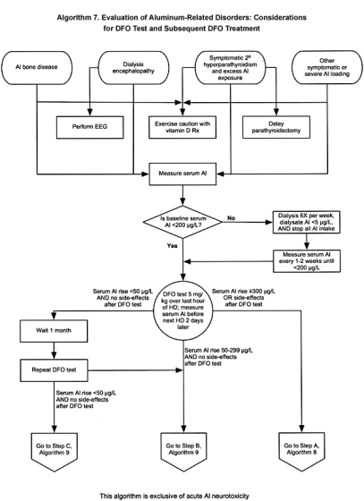
Our order:
Containers
Iterators (ranges)
Algorithms
Notes:
http://cookpaintings.com/Cook_Paintings/Open_Range_files/Open%20Range%20small.jpg
http://www.kidney.org/professionals/kdoqi/guidelines_bone/Images/Algorithm7L.jpg

Slide 21

NOTE: Most items we cover will have many, many class methods or overloads that we won’t cover

Slide 22
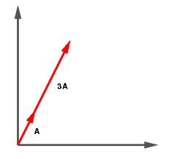
Our First STL Container
Vector
Like a dynamic, random-access array
Notes:
http://webphysics.iupui.edu/JITTworkshop/152Basics/vectors/gif/vecpic06.gif

Slide 23
vector

Slide 24

vector<T>
#include <vector>
A dynamic array
Notes:
http://www.windows2universe.org/the_universe/images/expanding.jpg

Slide 25

Use as the standard container unless you have a good reason to use another type
Notes:
http://c810422.r22.cf2.rackcdn.com/wp-content/uploads/2010/06/cisco-managed-services-in-a-box.jpg

Slide 26
Array-indexing syntax:
vector<int> v(10);
v[0] = 4;

Slide 27

vector<T> Constructors
vector<T>()
vector<T>(size_t num_elements)
Initially has num_elements allocated
vector<T>(size_t num, T init)
Initially has num elements of value init
Notes:
http://www.skowkale.com/graphics/under-construction.gif

Slide 28



Vector<T> Properties
v.empty()
true if v has 0 elements
v.size()
number of elements
v.capacity()
number of elements v can hold before allocating more memory (cap ! nec. = size)
usually doubles
Notes:
http://thinkprogress.org/wp-content/uploads/2012/03/empty.jpg
http://maycraft.com.my/Images/Category/Measuring_Tape04002011.jpg
http://cdn.bleacherreport.net/images_root/slides/photos/002/130/493/footbl-250_display_image.jpg?1334411023

Slide 29

Adding elements to a vector<T>
v.push_back(42);
increases size, adding to the end
v[0] = 31;
only ok if v.size() >= 1
Notes:
http://www.really-learn-english.com/image-files/push.gif

Slide 30

Adding elements in a specific place
v.insert(iter before, T val)
iter?????

Slide 31

Detour: What’s an Iterator?
Iterator is like a pointer that is specific to the container (in this case, vector)
Notes:
http://dogbreedsites.com/wp-content/uploads/2012/01/German-Shorthaired-Pointer-puppies-4.jpg

Slide 32
Declared like this:
vector<char *>::iterator i = v.begin();
assume that v is a vector<char *>

Slide 33


v.begin() returns an iterator to the first element in the vector
v.end() returns an iterator to just past the last element in the vector
Notes:
http://gaypoly.files.wordpress.com/2011/01/begin.png
http://1.bp.blogspot.com/-xU9kkolt0fQ/UGTKN3hDZsI/AAAAAAAAAww/SNN4h8YAiv0/s1600/the-end.jpg

Slide 34
Equivalence of Traversal?
Use an iterator to traverse a vector:
for (vector<char *>::iterator i = v.begin();
i != v.end(); ++i)
cout << *i;

Slide 35



It's like a Pointer!
It can point at elements in the vector
It can be dereferenced using *
It can be incremented or decremented
Notes:
http://grtaylor2.com/wp-content/uploads/Asterisk.jpg
http://1.bp.blogspot.com/-SiMzaqyn_3E/T5O_CztXSDI/AAAAAAAAAE4/PWE8Z1ZUw1M/s1600/increment_logo.png

Slide 36

Back to vectors ...
Notes:
http://images5.fanpop.com/image/photos/29400000/Back-To-The-Future-Wallpapers-back-to-the-future-29447185-1366-768.jpg

Slide 37
Accessing elements
v.at(i)
reference, range checked!
v[i]
reference, not range checked

Slide 38

v.front()
reference to first element
v.back()
reference to last element
e.g. v.back() = 4; // legal if size > 0
Notes:
http://jeancompton.com/wp-content/uploads/2011/04/sjcf_01_img0215.jpg

Slide 39
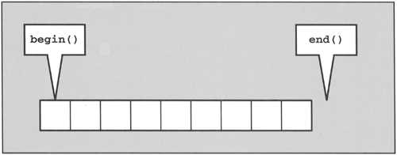
Accessing elements through iterators
v.begin() returns an iterator to the first element in the vector
v.end() returns an iterator to just past the last element in the vector
Notes:
http://3.bp.blogspot.com/-2F78J5ufSt4/Tsk9xDLVBZI/AAAAAAAAChQ/Yp6_LYnaQSo/s640/begin+and+end+for+container.png

Slide 40
v.begin() can be dereferenced
v.end cannot be dereferenced
This behaves like the NULL pointer at the end of a linked list
It's used to determine when to stop loops

Slide 41

Important to remember!
v.front() and v.back() give you values
Notes:
http://rlv.zcache.com/navy_core_values_kanji_only_on_front_of_shirt-rdc9b216e543241b1b1d6d77b0ce83d47_804gs_512.jpg

Slide 42
v.begin() and v.end() give you iterators (like pointers)
end()
begin()

Slide 43

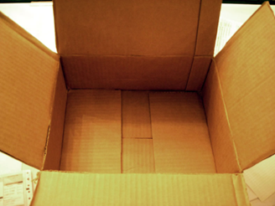
Removing elements
v.pop_back():
removes last element, returns nothing
v.clear()
removes everything
Notes:
http://userserve-ak.last.fm/serve/_/7780027/Almighty+Presents+Pop+Back+To+The+80s.jpg
http://3.bp.blogspot.com/-_gbAWeYsKP4/T899GpY3CSI/AAAAAAAAACw/du8qLqu4xEo/s1600/empty.jpg

Slide 44

v.erase(iter i)
erase element at that iterator
Notes:
http://upload.wikimedia.org/wikipedia/commons/d/db/Barnstar_erase.png

Slide 45
v.erase(iter start, iter onePastTheEnd)
erase all elements in that range (excl. the last), shifting the remaining elements if needed

Slide 46


Time efficiency
constant time insertion and removal of elements at the end
linear time insertion and removal of elements at the beginning or in the middle
Notes:
http://3.bp.blogspot.com/-bZ0nGvbkFwE/UMWzc0D5f5I/AAAAAAAAABk/InLdVM_CRoE/s1600/TLT+IMAGE+speed_limit.jpg
http://www.customfitonline.com/media/69296/site-speed.jpg

Slide 47

This is …
The “standard” container

Slide 48
Try out the example
on eConestoga

Slide 49
Summary
The STL can be very useful.
vector is the standard container.

